Slide 1

KEYLOGGER
Presented By:
Shruthika.S
Btech IT
Anjalai ammal mahalingam engineering College

Slide 2

OUTLINE
Problem Statement
Proposed System/Solution
System Development Approach
Algorithm & Deployment
Result
Conclusion
Future Scope
References

Slide 3
PROBLEM STATEMENT
In today's digital age, where cybersecurity threats loom large, one of the significant concerns is the proliferation of keyloggers, stealthy software tools designed to monitor and record keystrokes on a user's computer without their knowledge.
Keyloggers pose a severe threat to individuals and organizations as they can capture sensitive information such as passwords, credit card details, and other personal data, leading to identity theft, financial loss, and privacy breaches

Slide 4
PROPOSED SOLUTION
Data Collection:
Collect a wide range of keystrokes from different keyboard layouts, languages, and typing habits.
To effectively train the machine learning model, this dataset should ideally comprise both typical typing activities and instances of keylogging activities.
Data Preparation:
Feature extraction: Take pertinent aspects, including key combinations, timings between keystrokes, and press durations, and extract them from the keystroke data.
Data cleaning: Purge the dataset of any noise or anomalies.
Data normalization: To guarantee consistency and enhance the performance of the model, normalize the features.
Machine Learning Algorithm:
To train the model, use a supervised learning technique like Gradient Boosting Machine (GBM), Random Forest, or Support Vector Machines (SVM). These algorithms work well for classification tasks and are capable of telling the difference between keylogging activity and regular typing.
Deployment:
Incorporate the machine learning model that has been trained into a system or program that can track keystrokes in real-time and continually. Depending on the particular needs of the users or organizations, this application should either run as a standalone application or be integrated into the operating system.
Evaluation:
The machine learning model should be integrated into a real-time tracking system, either as a standalone application or integrated into the operating system, depending on user needs.
Result:
The system effectively detects and neutralizes keylogging risks by recognizing suspicious keyboard patterns, and its performance can be enhanced through ongoing monitoring and upgrades.

Slide 5

SYSTEM APPROACH
In a system approach to addressing the threat of keyloggers, each component plays a crucial role in ensuring comprehensive protection against these malicious tools. Here's a suggested structure for this section:
Endpoint Detection and Response (EDR) Systems
Behavioral Analytics
Encryption
Intrusion Detection Systems (IDS)

Slide 6
ALTERNATIVE RESOURCES
ALGORITHM & DEPLOYMENT
In the Algorithm section, describe the machine learning algorithm chosen for predicting bike counts. Here's an example structure for this section:
Algorithm Selection:
Provide a brief overview of the Choosen appropriate machine learning algorithms such as logistic regression, random forest, or neural networks for keylogger detection based on factors like performance, scalability, and interpretability.
Data Input:
Specify the input features used by the algorithm, including system logs, network traffic, user activity logs, and file system changes to capture potential indicators of keylogger activity.
Training Process:
Explain how the algorithm is trained using historical data. Train the selected machine learning algorithm using labeled training data to learn patterns indicative of keylogger activity.
Prediction Process:
Detail how the trained algorithm ,apply the trained model to new data instances to classify and identify potential keylogger activity.

Slide 7

Result
Present the results of the machine learning model in terms of its accuracy and effectiveness in classifying and identifying potential keylogger activity, demonstrating its effectiveness in detecting this type of threat.t the model's performance.

Slide 8

CONCLUSION
In the digital age, keyloggers are a serious threat to the protection of sensitive data. In order to protect people and businesses from identity theft, financial loss, and privacy violations, effective countermeasures are crucial.

Slide 9
FUTURE SCOPE
Enhanced User Interface:
Implement a more intuitive and visually appealing user interface using Tkinter or other GUI frameworks.
Encryption:
Enhance security by implementing encryption for the log files to protect sensitive data
Machine Learning Integration:
Integration with machine learning algorithms can improve the accuracy and predictive capabilities of the code.
Scalability:
The code can be scaled to handle larger datasets by optimizing algorithms and implementing parallel processing techniques.

Slide 10
REFERENCES
https://www.researchgate.net/publication/228797653_Keystroke_logging_keylogging
https://www.researchgate.net/publication/309230926_Survey_of_Keylogger_Technologies

Slide 11
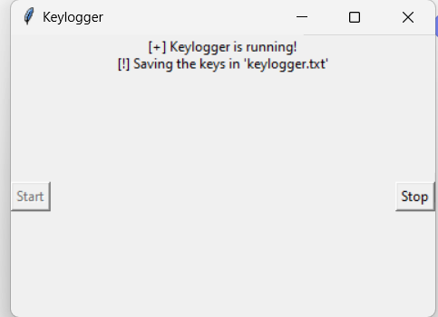
OUTPUT

Slide 12

THANK YOU

